Slide 1

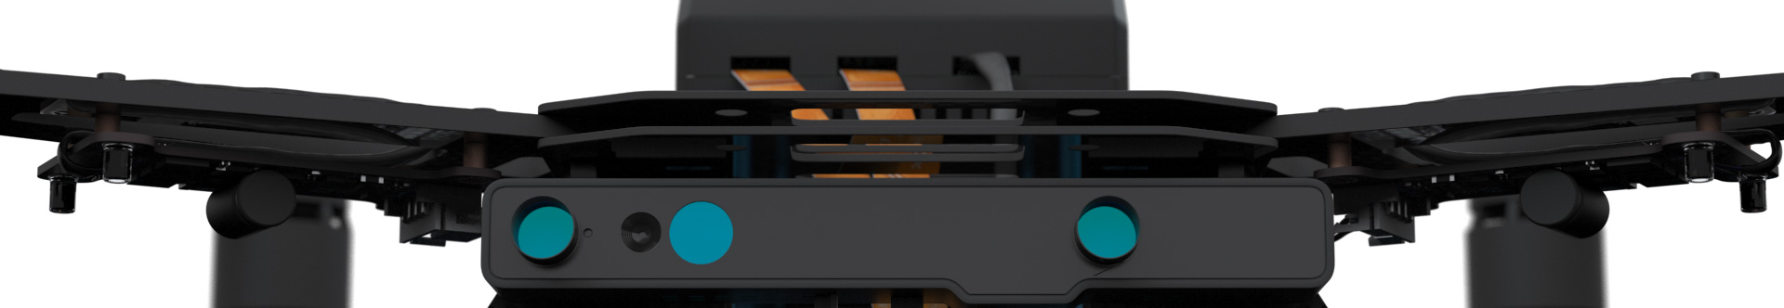
Autonomous Drone Engineer B2 – Hardware Architecture
Paul.Guermonprez@intel.com Autonomous Drone Solutions Architect

Slide 2
RealTime and Smart

Slide 3
Flight Controller = Real Time
A quadcopter needs to balance the 4 motors:
very quickly
constantly
without interruption
That’s why this task is managed by a simple microcontroller. Ex: STM32
The microcontroller has limited processing power, but it is a deterministic behavior. You can be sure it will run your software in time. It is real-time.

Slide 4
Compute Board = Smart
If you need your drone to follow a simple GPS path, a microcontroller is enough. But if you want your drone to be autonomous, you’ll need to avoid collision avoidance, perform computer vision tasks, communicate over IP networks. You’ll need a compute board, typically running Linux.
This board will be connected to sensors like Intel RealSense, run complex software stacks and interact with the network. This type of heavy computation is usually not done in real time.

Slide 5
Summary
There’s a clear separation of tasks:
Simple real time computation by the flight controller
Complex computations by the compute board
It is a typical architecture for autonomous drones.
By working with Intel Aero, you develop durable and interoperable skills.

Slide 6
Compute Architecture

Slide 7
(De)Centralized? Generic/Specific?
Trends in computer history:
PCs and servers: Centralized generic computing (IA CPUs, + GPU)
Mobile world: Dedicated decentralized computing (modems, IPUs, …)
HPC trend: Centralized parallel and specific computing (CPU OR GPU)

Slide 8
(De)Centralized? Generic/Specific?
Proposed architecture for drones:
Central generic computing for logic and custom code (Aero board)
Decentralized specific computing for
3D sensing (RealSense)
CV (Movidius)
Radio (LTE modem)
FPGA

Slide 9
Communications

Slide 10
Communications
Two systems:
Peer2Peer:
Wifi P2P (consumer IP based RC Drones) Usually highly optimized long range wifi, can support HD Video
Radio P2P (hobbyist RC drones) Great for low latency
Centralized:
Wifi (uncommon, problem with wifi strengh)
Mobile networks like LTE (obvious choice for long range autonomous drones)
Drones flying in the same space do not requireP2P radio comms Only centralized mobile based communications are scalable
Intel Aero board has wifi included and supports M.2 professional LTE modems

Slide 11
Conclusion

Slide 12
Conclusion
Intel Aero platform is:
built from Best Known Methods
proposing a compute architecture that’s both flexible and powerful
a good platform to develop skills, as it based on standards

Slide 13
Thanks
Paul.Guermonprez@intel.com
https://intel-aero.github.io
Released under Creative Commons-BY creativecommons.org/licenses/by/2.0/

